Slide 3
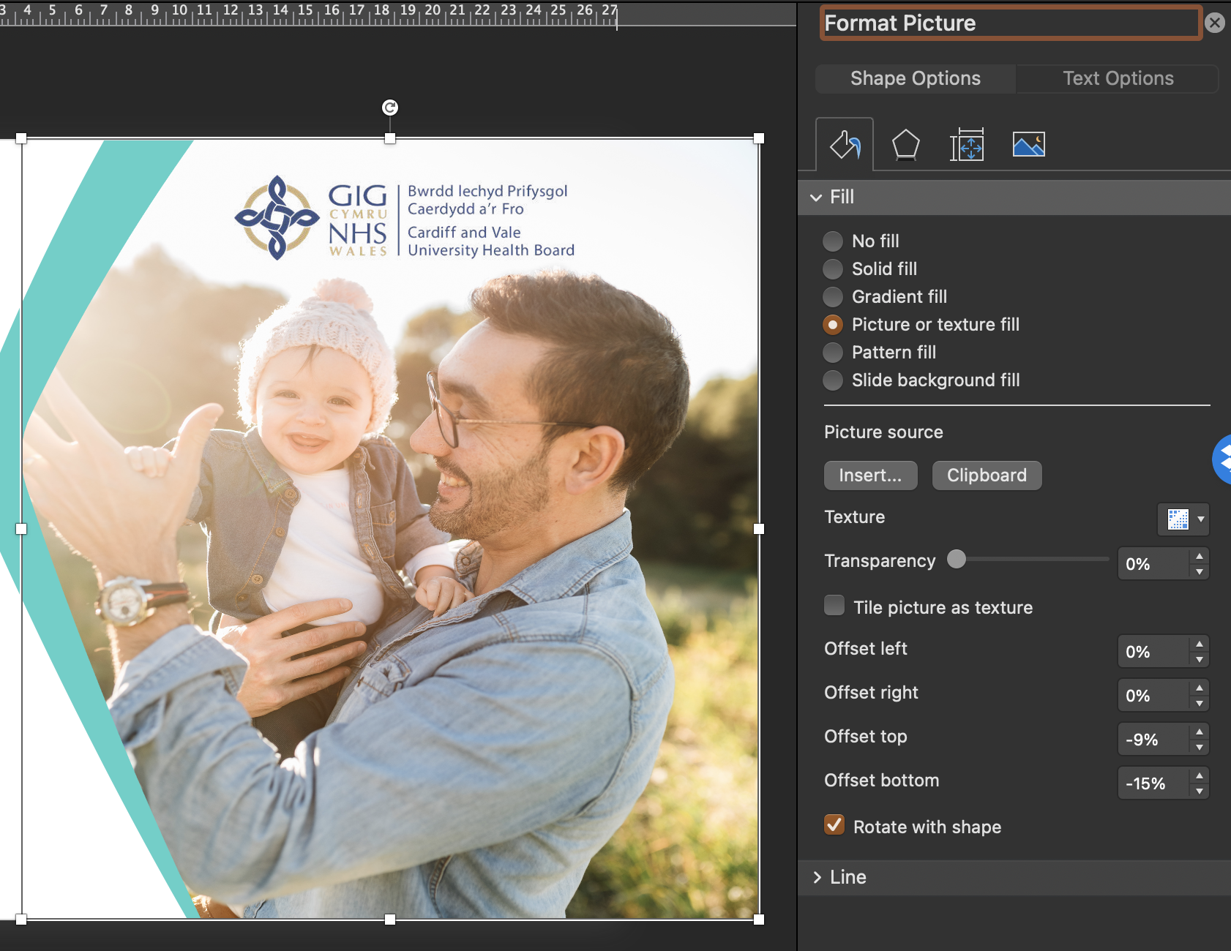
How to change an image
To change a slide image double click or menu click and select ‘Format Picture’ then under ‘Picture Source’ select ‘insert’ then choose the new image you’d like to use. If the image needs adjusting select ‘Format’ then ‘Crop’ to reposition.

Slide 14
Example Heading
Example text

